Slide 1
Software Architecture
Assignment: Multiplexing system architecture for network devices
Name: Sakthi Kumar Chandrabose
Mail ID: 2021MT13011@wilp.bits-pilani.ac.in
ID: 2021MT13011

Slide 2
Purpose of the system
In a network device(router in this case) there may be ‘n’ number of interfaces. There might be cases in which the user wants to send 1 GBPS traffic but since the interface max is 100 MBPS he might be limited to that levels. This propriety system can converge multiple interfaces to a single interface so that user can use all the interfaces of a router to send traffic through efficiently based on available bandwidth.

Slide 3
Functional requirements
UI must be available to configure which all interfaces can be clubbed together to form a multiplexed interface and view the same.
CLI interface must be available to configure which all interfaces can be clubbed together to form a multiplexed interface and view the same.
Once interfaces is multiplexed there must be a return value of new effective bandwidth post multiplexing.
All changes must be coded in C and provided as library with open API interfaces to automate testing for developers and testers.
For clubbing and un-clubbing there must be notification to intimate user/customer that this action can result in existing traffic reset.

Slide 4
Non-Functional requirements
Performance – Multiplexing puts load on CPU and the CPU usage caused by multiplexing must not exceed more than 20%
Availability - Multiplexing / demultiplexing must have a max turnaround time of 0.01 micro-second per MBPS
Portability – This library must be portable towards variety of linux OS and cloud interfaces
Interoperability - Between all available and upcoming devices demultiplexing feature must work.

Slide 5
Utility Tree
Quality attribute | Attribute refinement | Scenario | Business value | Architecture impact
Performance | Scalability | Multiplexing puts load on CPU and the CPU usage caused by multiplexing must not exceed more than 20% | High | High
Performance | Response time | Multiplexing / demultiplexing must have a max turnaround time of 0.01 micro-second per MBPS | High | High
Portability | Platform support | This library must be portable towards variety of linux OS and cloud interfaces | Medium | High
Interoperability | Unified user experience | Between all available and upcoming devices demultiplexing feature must work | Medium | High
Usability | Correctiveness | Traffic multiplexing must not jumble the packet order | High | Medium
Usability | Notification | Combined bandwidth must be displayed once configured reducing the tolerance value | Low | Low
Security | Correctness | Traffic destined for different end device must not be wrongly delivered | High | High

Slide 6
Tactics to Achieve top 5 ASR`s
Quality attribute | Scenario (ASR) | Tactics
Performance | Multiplexing puts load on CPU and the CPU usage caused by multiplexing must not exceed more than 20% | Once first flow is initiated, we can cache the flow details to page table so that CPU cycle is not used to refer how the original packet needs to be packed. In cases where we have a DPDK engine we can advice the same to do the same for which dpdk programming module needs to be written.
 | Multiplexing / demultiplexing must have a max turnaround time of 0.01 micro-second per MBPS | For protocols which involve sending multiple small packets don’t multiplex and send it directly over original interface. Once a flow drain point is selected stick to the same unless and until the existing interface goes down

Slide 7
Tactics to Achieve top 5 ASR`s (CONT.)
Quality attribute | Scenario (ASR) | Tactics
Usability | Traffic multiplexing must not jumble the packet order | All traffic must be treated as flows An outer IP header needs to be used to hold the flow information and all the packets that is being sent must hold this details The outer IP header must include sequence number which can be used on the draining end to order the packet
Security | Traffic destined for different end device must not be wrongly delivered | The outer IP header must be in fixed IP header size without options, since the packet is not encrypted with specific header size end IP can be found and flow information must be selected based on that.

Slide 8
Tactics to Achieve top 5 ASR`s (CONT.)
Quality attribute | Scenario (ASR) | Tactics
Interoperability | Between all available and upcoming devices demultiplexing feature must work | Since deployment of this will be done in all the old and new router models, we must ensure that library is not dependent on any underlying HAL (hardware layer). This can be achieved by coding an abstraction layer to control the same. The abstraction code will hold which bits to set for mode type.
Portability | This library must be portable towards variety of linux OS and cloud interfaces | Individual abstraction layer which is not part of the library must be coded to ensure that when we move between variations of linux its wont cause issue. The abstraction layer will hold system specific calls for that specific linux / cloud os system.

Slide 9
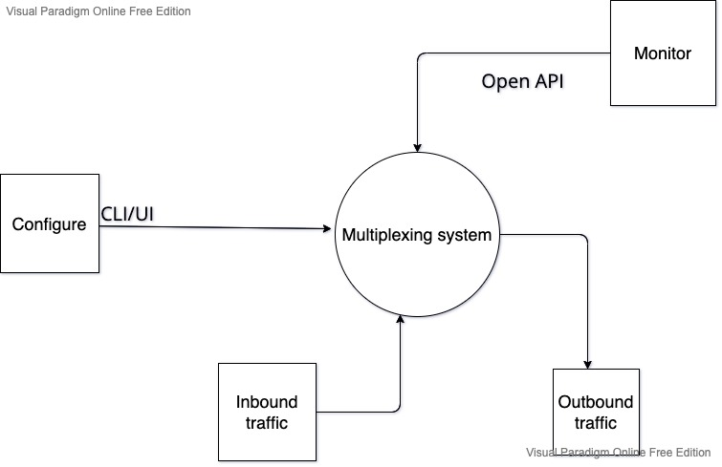
Context diagram

Slide 10
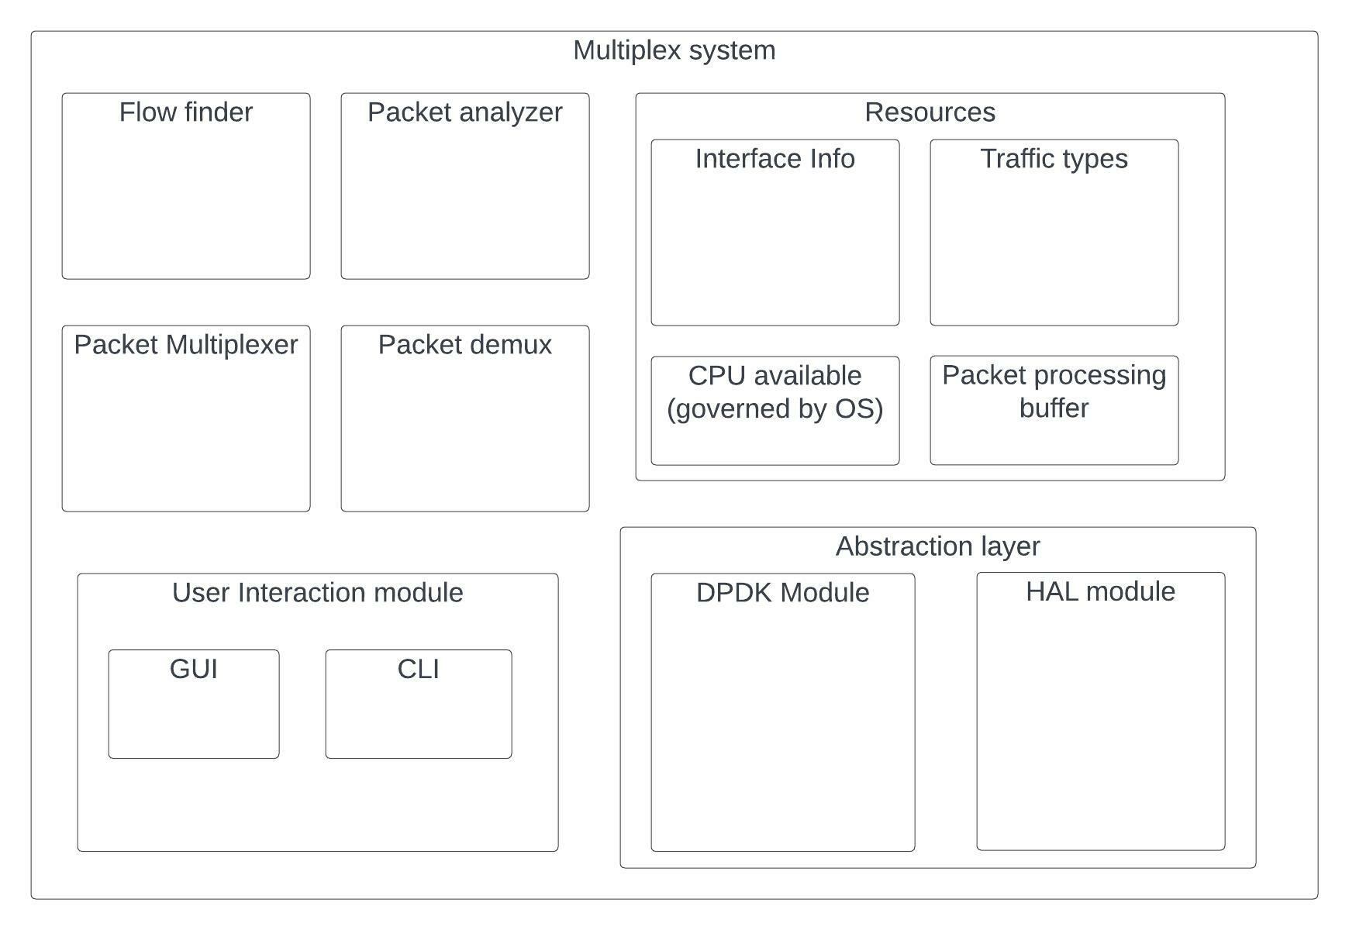
Module decomposition

Slide 11
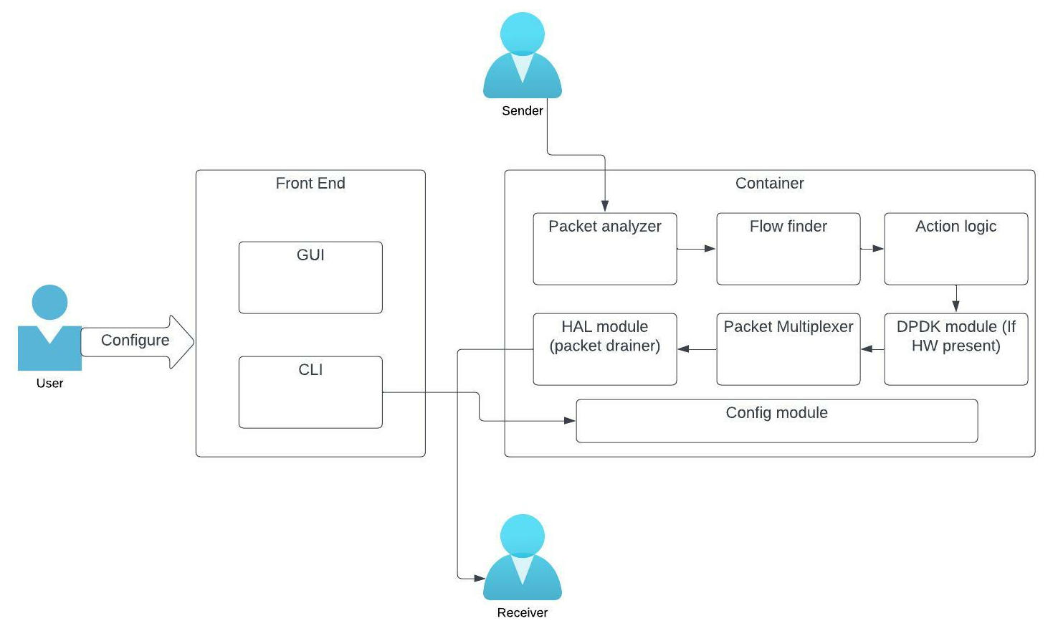
Component connection Diagram

Slide 12
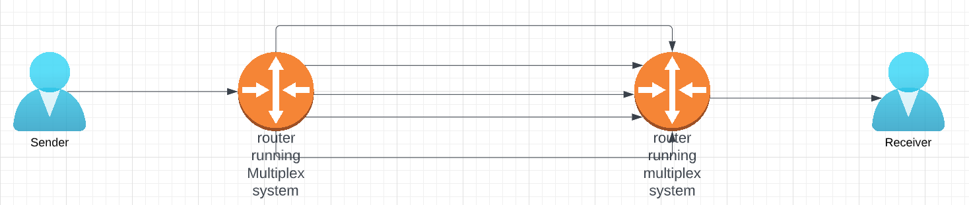
Deployment diagram

Slide 13
How does Multiplexer work
User configures which all interface needs to be clubbed together as single interface using either GUI or CLI (Front end).
Internal system validates if the interfaces selected can be clubbed together and if its possible it will create a single virtual tunnel tun1 and will return the maximum bandwidth possible which will be 90% of total bandwidth of all interfaces we have clubbed together
Now sender will send the traffic.
Packet analyzer will receive the traffic and check if for this traffic multiplex is required. This will be done based on underlying protocol and size of the packet
For FTP, SCP and similar traffic it is assumed that the data that needs to be sent over network is more
So, packet analyzer will forward the packet to flow analyzer
Flow analyzer will lookup its table to see if this is a new traffic or old traffic

Slide 14
How does Multiplexer work (contd.)
If its existing traffic, then the flow which we have fetched will be cached and traffic will be sent via that flow
If not, then new flow will be created, and sequence number will start from 0.
New IP header will be appended in Multiplexer or alternatively if DPDK is present then DPDK will be programmed for this flow to do the same.
Once packet is multiplexed it will be sent to packet drainer which will find the grouped up tun interface and send the packet out.
On receiving end once the packet is received it will reach packet analyzer which with the help of flow finder will find the appropriate flow and demux the packet
Once it is done it will be forwarded to the receiver.

Slide 15
Key learnings
Visualing all components in utility tree and marking architectural impact gives us a rough estimate of how much work load a specific module is going to take
Separating requirements to functional and nonfunctional requirement gave an exact idea where performance drop will be there and how it can be managed.
Since this system is supposed to be modular, component connection diagram and module decomposition diagram gave me few more extra ideas how I can improve this portable system.
Deployment diagram can be used to explain customer what exactly is going to happen in the system rather than having more technical terms.
Till this point of time, I have not though about different modules that has been present in this system and why they have designed it this way. Once I saw it has individual modules lots of angles like in perspective of design, security, performance, scalability I can understand why the system has been designed in this way.

